Slide 1
Is the Walt Disney Company still worth to Invest?
Recommendation for company and investors
Course #.: ACCY 6900
Professor: Yanfeng Xue
GWID: 45681867
Author: Yuwen Luo
Notes:
Recommendation for
Company
Investor

Slide 2
Contents
Introduction
Roadmap
Business Model
Financial Ratio Analysis
Liquidity Ratios
Asset Ratios
Profitability Ratios
Debt Ratios
1
2
Revenue Analysis
Market Segment Analysis
Parks, Experiences
and Products
DTC & Internetional
3
4

Slide 3
Roadmap
Introduction
Financial Analysis
Revenue Analysis
Market Segment Analysis
1950–1966:
Television
Disneyland
Walt Disney's death
1984–2005:
Michael Eisner's leadership
Disney Renaissance
"Save Disney" campaign
2020–present
Bob Chapek's leadership
COVID-19 pandemic
1
3
5
2
4
1966–1984:
Roy O. Disney's leadership and death
Walt Disney World
2005–2020:
Bob Iger's leadership Company expansion
Notes:
Walt and Roy Disney formed Disney Brothers Cartoon Studio in 1923 after the bankruptcy of Disney’s previous firm.
In January 1926, with the completion of the Disney studio on Hyperion Street, the Disney Brothers Studio's name was changed to the Walt Disney Studio
On December 16, 1929,, the Walt Disney Studios partnership was reorganized as a corporation with the name of Walt Disney Productions, Limited, with a merchandising division – Walt Disney Enterprises, and two subsidiaries – Disney Film Recording Company, Limited;
In 1986, the company changed its name to The Walt Disney Company. The Walt Disney Company established itself as a leader in the American animation industry before diversifying into live-action film production, television, and theme parks.
Robert A. Iger owns a total of 1,150,138 Disney shares, representing 0.06% of the company's total shares outstanding.Iger is Disney's Executive Chairman and Chairman of the Board of Directors. Christine M. McCarthy owns a total of 141,301 Disney shares, representing 0.01% of the company's total shares outstanding. McCarthy first joined Disney in 2000 and is currently the company's Senior Executive Vice President and Chief Financial Officer (CFO). Alan N. Braverman owns a total of 98,922 Disney shares, representing 0.01% of the company's total shares outstanding. Braverman is Senior Executive Vice President, General Counsel, and Secretary. Institutional investors hold the majority of Disney's shares at about 63-65% of total shares outstanding.

Slide 4
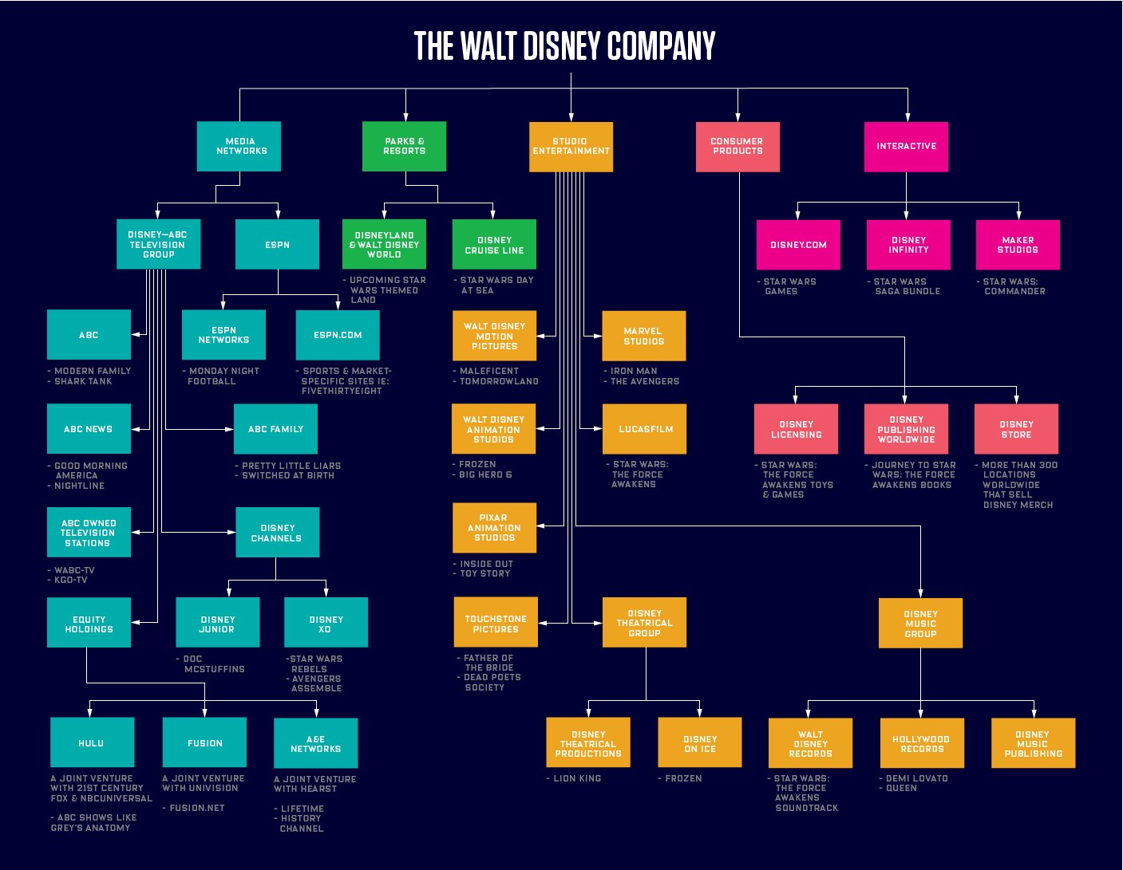
Business
Model
Introduction
Financial Analysis
Revenue Analysis
Market Segment Analysis

Slide 5
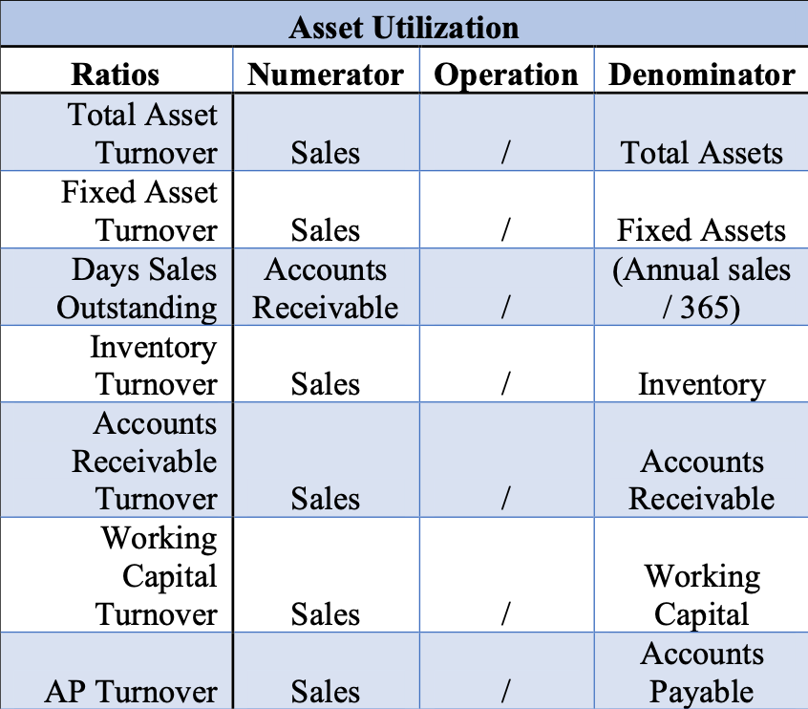
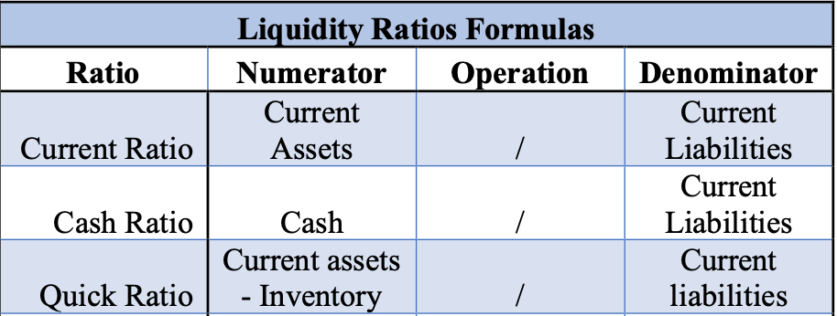
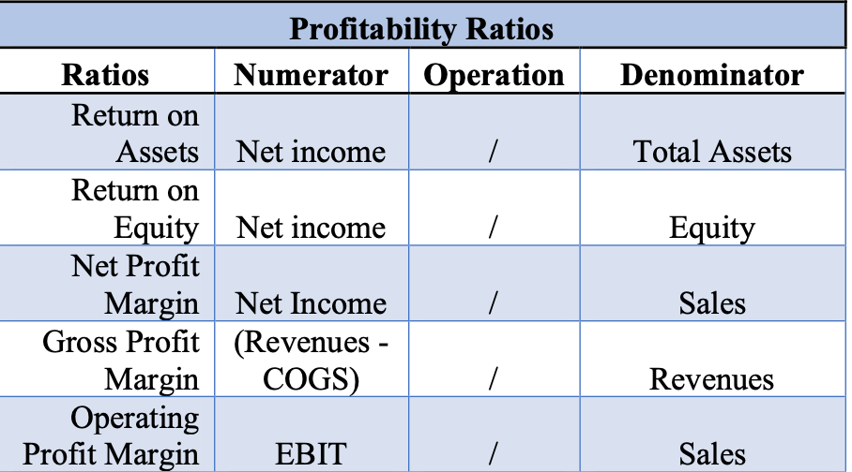
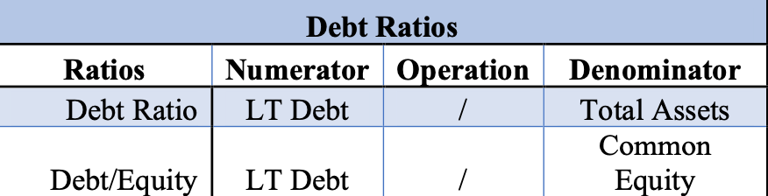
Financial Analysis
Introduction
Financial Analysis
Revenue Analysis
Market Segment Analysis
Ratio Analysis
Liquidity Ratios
Asset Ratios
Profitability Ratios
Debt Ratios
Notes:
Granted, by reviewing financial statements alone, we can see if a company is increasing or decreasing the revenues. Further, we are also able to identify, relatively quickly, whether an organization is profitable by just looking at their net profits. However, in my most humble of opinions, the true essence of financial analysis lies within financial ratios.
The power of financial ratios comes from their ability to show how a company is performing, as a percent of a benchmark. By using percentages, we can compare financial ratios, in a meaningful way, with industry competitors, as well as historically. These comparisons allow us to identify performance and other trends within a company, as well as trends within an industry.

Slide 6
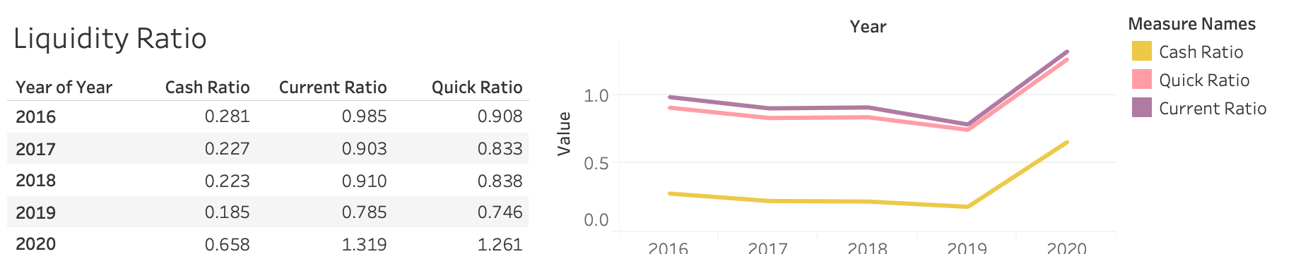
Liquidity Ratio
Introduction
Financial Analysis
Revenue Analysis
Market Segment Analysis
Conclusion
Cash Ratio: Investors should expect the company to shift back to a less-cash situation
Quick Ratio: Investors should anticipate the quick ratio falling back to the 80% level
Current Ratio: The firm was able to project the perception of liquidity
Notes:
Liquidity Ratios have similar trend that they both continually reduce from 2016 to 2019, then have a breakpoint in 2019 and substantially increased in 1 year.
Cash Ratio:
The company's cash ratio ended in 2016 at 28%. In the next three years, the organization would continually reduce its cash ratio ending 2019 at 17%. However, in 2020, the firm would shift its cash strategy to include elevated liquid assets. This resulted in the company's cash ratio being 65% in 2020.
By holding more cash, the firm positioned itself to better weather the recessionary economic cycle in the US as well as its various parks being shut down. In the next several years, investors should expect the company to shift back to a less-cash dense position.
Quick Ratio:
Disney's quick ratio ended 2016 at 90.8%. In the next three years, the organization would reduce its quick ratio to .84 in 2019. However, in 2020, the organization substantially increased its quick ratio ending the year at 126%.
The main reason for the elevated quick ratio is that the firm is holding, again, a substantial amount of cash. Once the company's parks open up and their revenues start to increase, then investors should anticipate the quick ratio falling back to the 80% level.
Current Ratio:
The Walt Disney Company's current ratio for 2016 was 98%. The next year, it slightly declined to 90% in 2017. However, in the next three years, the current ratio for the company would substantially increase, ending 2020 at 130%.
It seems like the organization, between 2017 and 2019, had attempted to shift its business model to a lower current ratio strategy, well below the 1.0 threshold for most industries. This indicates that the firm was trying to use cash flows from its operations to cover current liabilities. However, in 2020, the firm shifted substantially in its current ratio strategy to embracing higher current assets as compared to current liabilities. This shift was a smart move because of the COVID19 issue. By shifting to a higher current ratio, the firm was able to project the perception of liquidity.

Slide 7
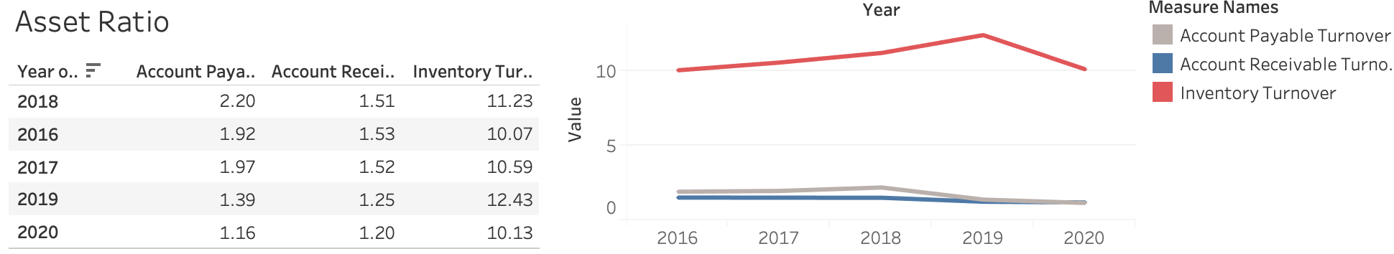
Asset Ratio
Introduction
Financial Analysis
Revenue Analysis
Market Segment Analysis
Conclusion
Account Payable Turnover: Set a consistent payment practice with suppliers
Account Receivable Turnover: Increase cash reserves
Inventory Turnover: Free up capital for reducing debt or investing in future projects
Notes:
Asset Ratios have various gap amount each ratio. For account payable turnover and account receivable turnover, they both slightly increase from 2016 to 2018, then fall to nearly 1 percent in 2020. For Inventory Turnover, it first increase 4% from 2016 to 2019, then slightly decreased in 2020 back to the same level in 2016.
Accounts Payable turnover:
Disney's Accounts Payable turnover ended from 2016 through 2018 at approximately 1.92. However, in 2019 and 2020, the company's Accounts Payable turnover would fall to 1.16.
The reduction in Accounts Payable turnover shows that the company is taking longer to pay their suppliers. Slow-paying suppliers do benefit Disney because the company is able to hold on to additional funds and use them in operations for the short term. However, by slow-paying suppliers, Disney risks having to pay higher costs for raw materials as well as suffering from supplier turnover. Both actions inevitably will directly or indirectly impact the organization's profits. A better strategy is for Disney to set a consistent payment practice with suppliers. By embracing a consistent and fair payment practice, Disney may be able to use this business model as leverage for negotiating lower raw material costs or improve quality for raw material.
Accounts receivable turnover:
Disney's accounts receivable turnover ended 2016 at 1.53. In the next two years, the organization's accounts receivable turnover would keep increasing, ending 2018 at 2.2. However, in the next two years, the organization's accounts receivable turnover would fall to 1.2, ending 2020.
The decrease in accounts receivable turnover again highlights the business model embraced by the organization, which is collecting their accounts receivable at a slower pace. As noted above, if the organization is going to be lax with its credit policy, then the organization needs to increase its cash reserves to ensure liquidity and solvency in the short term.
Inventory Turnover:
The Walt Disney Company's inventory turnover in 2016 was 10.07. In the next three years, the company would improve its inventory turnover ending 2019 at 12.43. However, in 2020, the company's inventory turnover would fall slightly, ending the year at 10.13.
For the most part, the company seems to be doing an excellent job of turning over its inventory as compared to revenues. Further, the company does seem to be making some improvements from 2017 to 2019. However, 2020 was a bit of a setback in their inventory turnover practice. Investors should anticipate Disney further improving its inventory turnover over the next several years. As the company's inventory turnover improves, then the firm should be able to free up capital for reducing debt or investing in future projects.

Slide 8
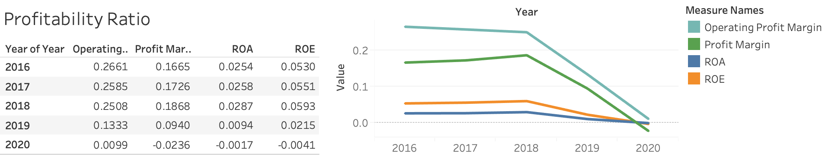
Profitability Ratio
Introduction
Financial Analysis
Revenue Analysis
Market Segment Analysis
Conclusion
Operating Profit Margin: Expect a moderate to substantial rise in operating profits
Profit Margin: Implement a better Accounts Payable practice
ROA: Suffer through the trough of low return on asset
ROE: Be compensated in correlation with the elevated risk taken on
Notes:
For profitability ratio, we can see they keep stable in the first 2 year, and all have a sharp decrease in 2018. In year 2020, profit margin even decrease down to a neagtive value.
Operating Profit Margin:
Disney's operating profit margin ended 2016 at 26.61%. In the next three years, the organization's profit margin would fall, ending 2019 at 13.3%. However, in 2020, the company's operating profit margin would fall substantially, ending the year at 0.99%.
The substantial decrease in operating profit margin should have been expected by investors due to Disney's parks being closed for a lengthy period of time. As Disney's parks increase occupancy, then investors should expect a moderate to substantial rise in operating profits, hopefully to 2019 levels.
Profit Margin:
The substantial and continued decline in profit margins shows that Disney is doing a poor job with either negotiating raw material costs or passing on the increased raw material costs to consumers through higher prices.
To help with future negotiations, Disney needs to implement a better Accounts Payable practice. Based on this review again, the organization needs all the help it can get in negotiating prices for raw materials.
ROA:
In 2016, Disney's return on assets ended at approximately 2.5%. In the next two years, the organization's return on assets would grow moderately, ending 2018 at 2.8%. Unfortunately, in the next two years, the organization's return on assets would fall substantially, ending 2020 at - 0.1%.
The substantial fall in return on assets shows that the organization may need to sell off fixed assets to increase optimization and operations. However, if the organization does anticipate a substantial increase in revenues over the next few years, then the company needs to just suffer through the trough of low return on asset returns. By suffering through lower return on assets now, the organization may be positioning itself for exponential revenue growth in the moderate term.
ROE:
Disney's return on equity ended 2016 at 5.3%. In the next two years, the organization's return on equity would increase substantially, ending 2018 at 5.9%. However, the organization's return on equity would continue to fall over the last two years ending 2020 at -0.41%.
The substantial fall in return on equity should concern investors. As an organization takes on more debt, almost always, the firm's return on equity will increase substantially. However, this is not the case for Disney. Granted, the Covid 19 problem has detrimentally impacted the company's profits. Regardless, as an organization increases its risk, or increases its debt load, then investors should be compensated in correlation with the elevated risk taken on.

Slide 9
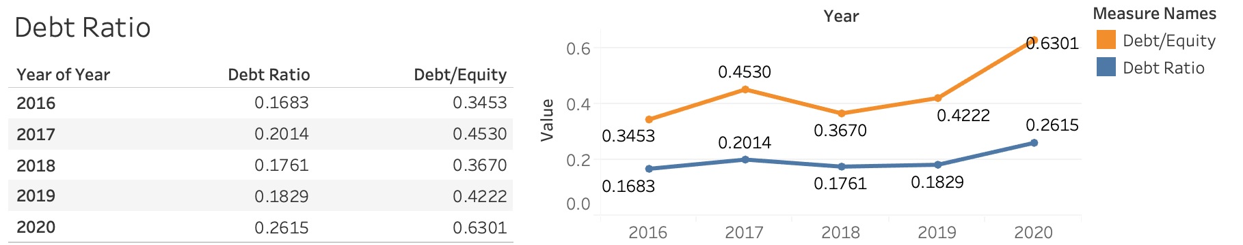
Debt Ratio
Introduction
Financial Analysis
Revenue Analysis
Market Segment Analysis
Conclusion
Debt/ Equity: Investors need to consider the risk tolerance caused by low debt to equity ratio
Debt Ratio: Investors should anticipate a reduction in overall debt over the next several years
Notes:
In terms of the Debt Ratio, they have similar trend that have a quick growth from 2016 to 2018, then stably increase after 2018 and double the increase rate in four years.
Debt/ Equity:
Disney's debt to equity ratio ended 2016 at 34.53%. In the next year, the organization's debt to equity ratio would increase moderately to 45.3% in 2017. In the next two years, 2018 and 2019, the organization's debt to equity ratio would fall again, ending 2019 at 42.2%. However, in 2020, the company's debt to equity ratio would increase substantially to approximately 64%.
For Disney to maintain a lower debt to equity ratio indicates that the firm mostly uses equity for growth and expansion as well as to cover operating costs. A benefit of this business capital structure is that the firm embraces a relatively low-risk financing strategy. However, by utilizing low amounts of debt, the organization is missing out on tax write-off opportunities as well as making money on borrowed money. From this, investors need to consider their risk tolerance.
Debt Ratio:
Disney's debt ratio ended 2016 at 16%. In 2017, the organization's debt ratio would increase moderately to 20%. In the next two years, the organization's debt ratio would continue to fall, ending 2019 at 18%. However, in 2020, the organization's debt ratio substantially increased, ending the year at 26%.
The substantial increase in the debt ratio for 2020 may have been due to Disney's need for short-term liquidity. From this need, the organization took on substantial debt. The recommendation of this case is investors should anticipate a reduction in overall debt over the next several years, which will inherently lower the risk for investment in the company.

Slide 10
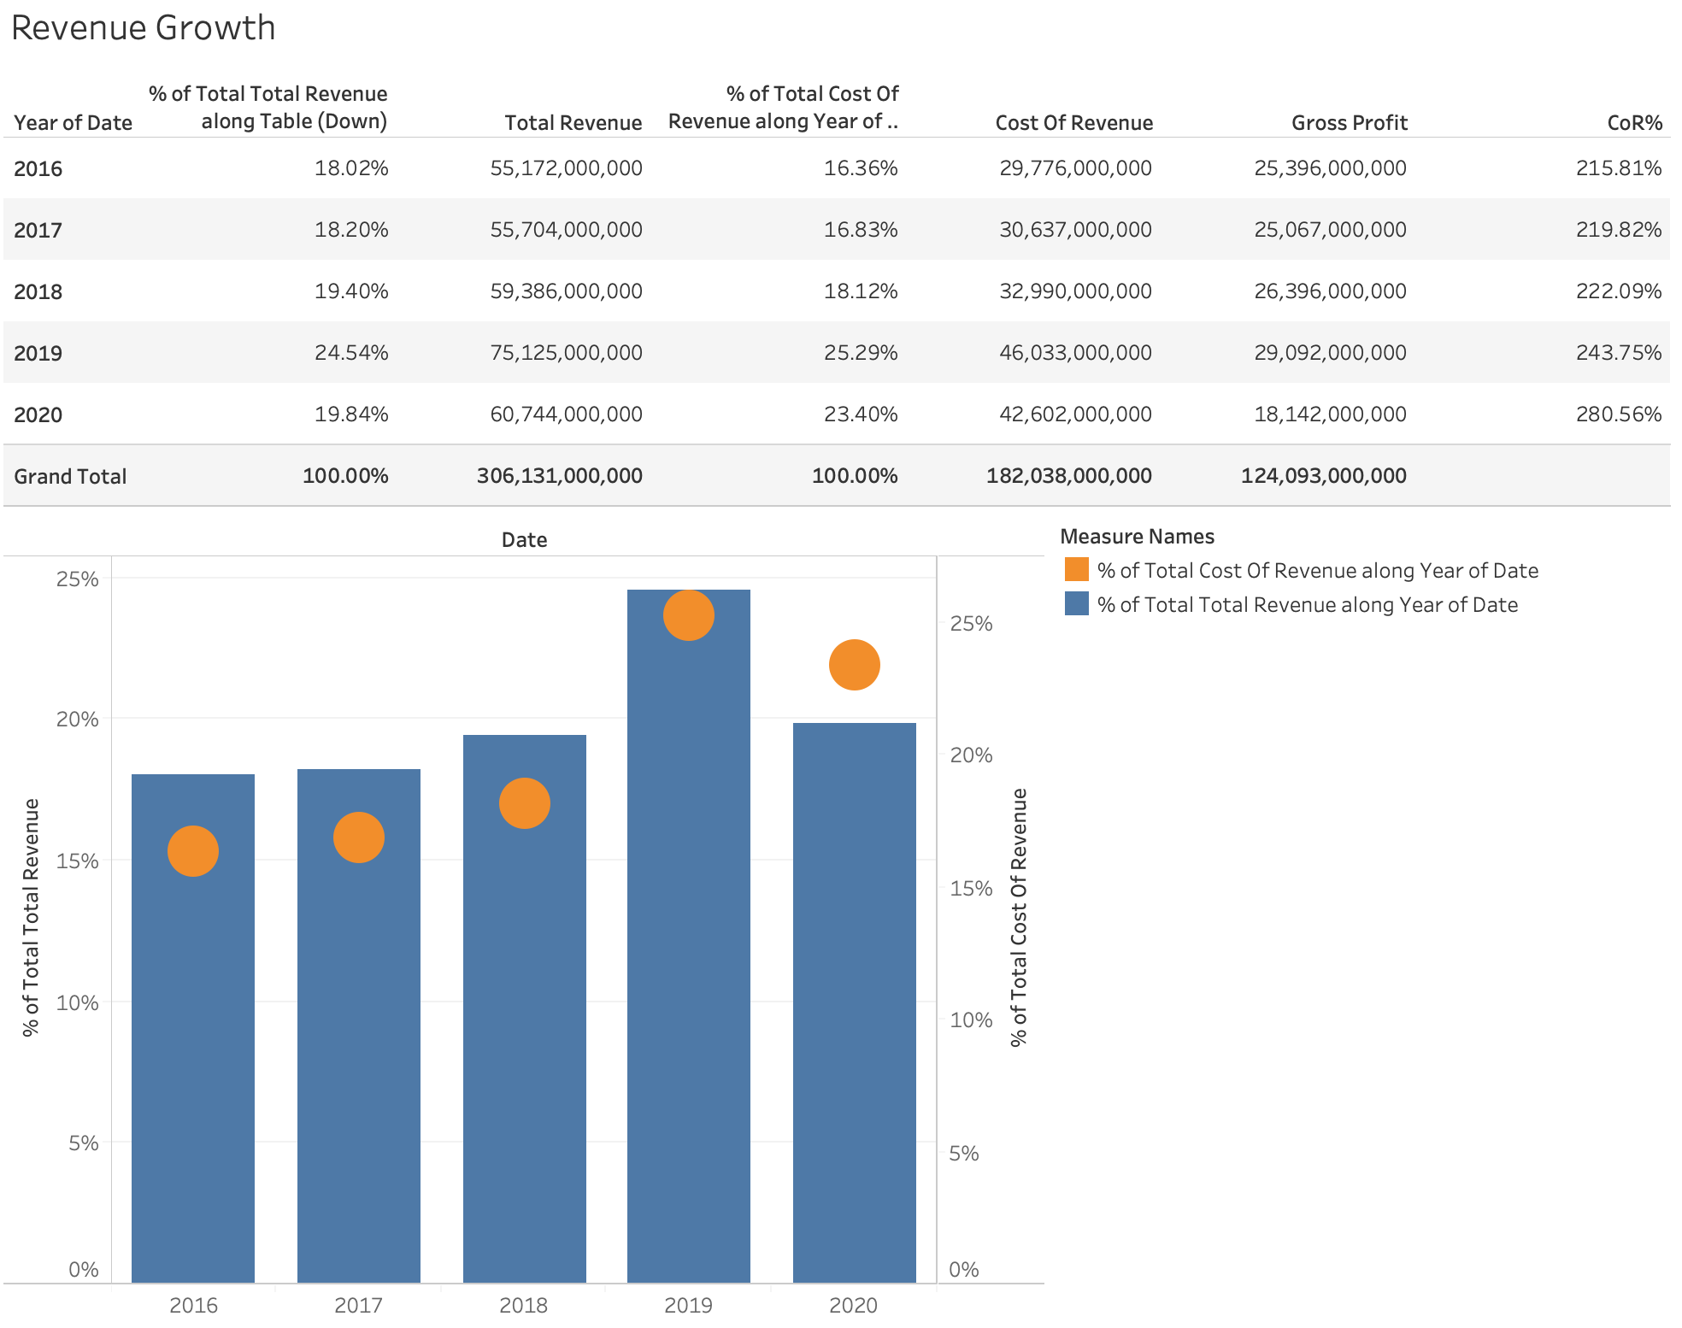
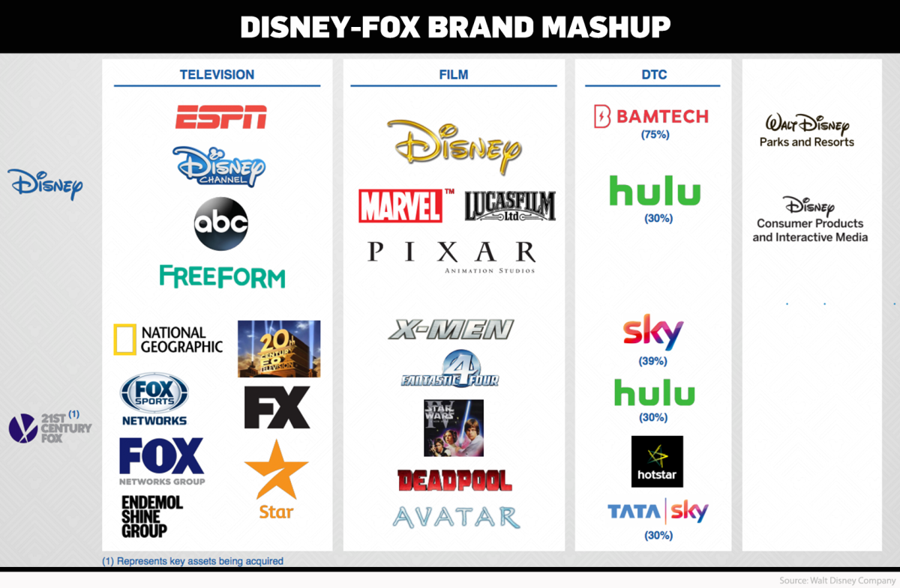
Revenue Analysis
Introduction
Financial Analysis
Revenue Analysis
Market Segment Analysis
Reason for 2019 Increase:
The Disney-FOX merger
Increased stake in Hulu
Strong performance in Parks and Resorts segment
Notes:
The sudden surge is expected to be driven by healthy growth in its media networks, parks and resorts, and studio entertainment businesses, benefiting from the Disney-FOX merger in early 2019 and an increased stake in streaming player Hulu.
Higher revenue would primarily be a reflection of benefits from the Fox acquisition, in the form of increased and high-quality content, higher subscribers, increased studio revenues, and an increase of 30% stake in streaming player Hulu.
Additionally, higher affiliate revenue, strong performance in Parks and Resorts segment, increased theatrical distribution, and higher sponsorship revenue, partially offset by pressure in home entertainment and licensing revenue, is set to boost revenue growth for Disney in 2019.

Slide 11
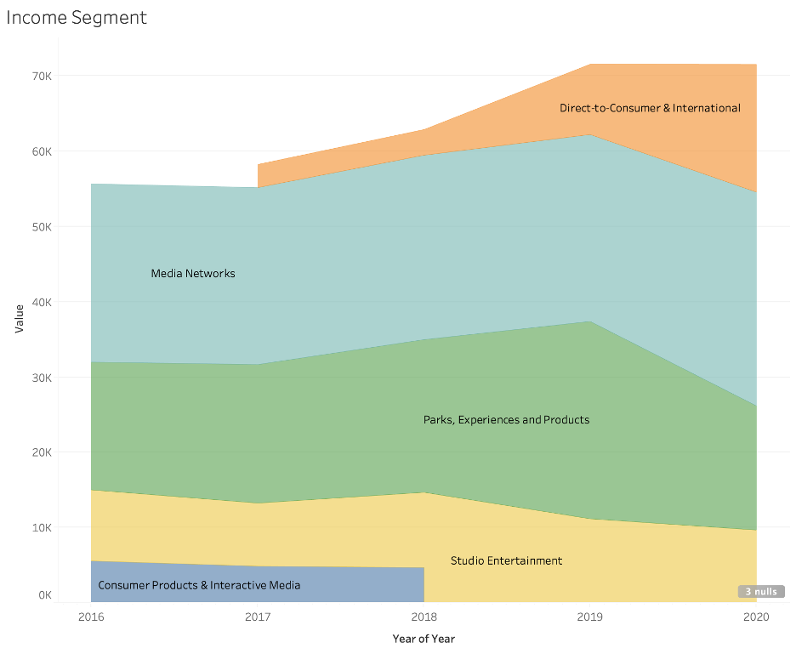
Market Segment Analysis
Introduction
Financial Analysis
Revenue Analysis
Market Segment Analysis
Direct-to-Consumer & International (new)
Media Networks
Parks, Experiences and Products
Studio Entertainment
Consumer Products & Interactive Media (old)

Slide 12
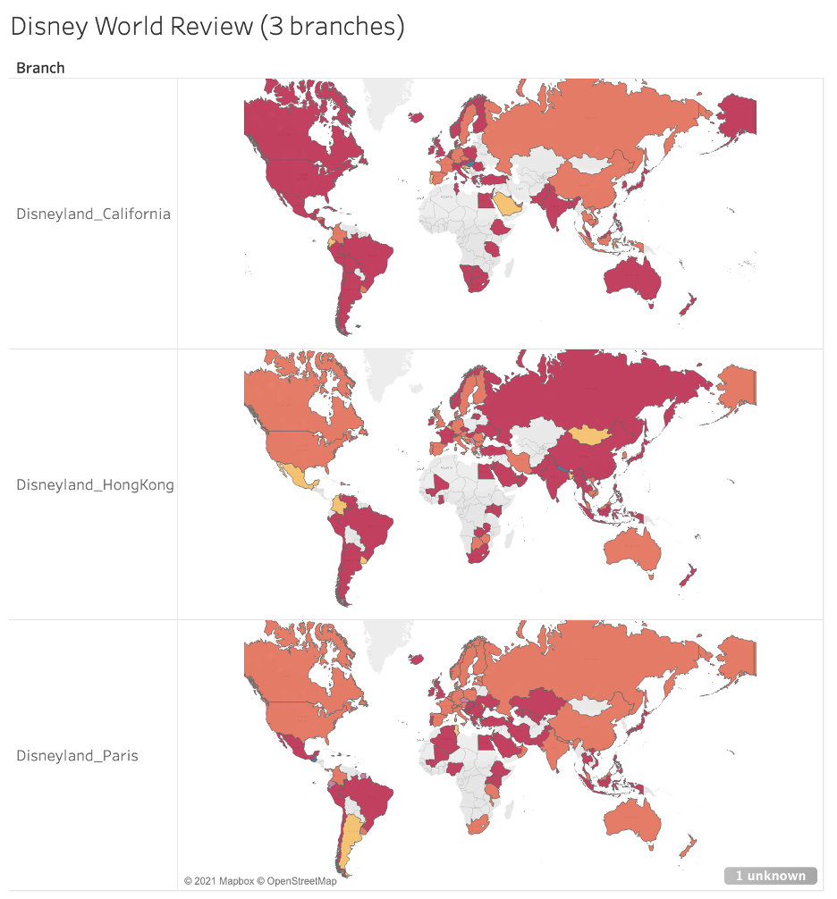
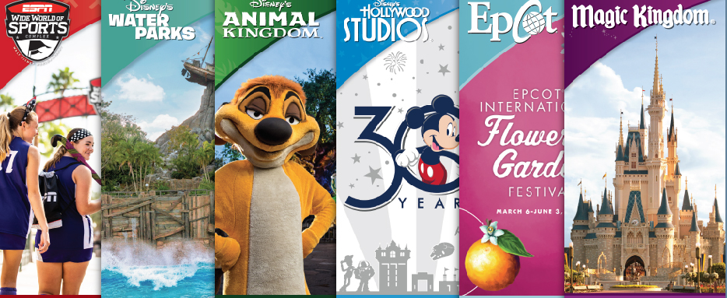
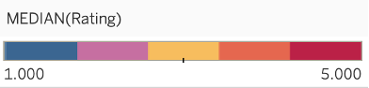
Market Segment Analysis
Introduction
Financial Analysis
Revenue Analysis
Market Segment Analysis
Parks, Experiences and Products
Rating of park is highly related to the location
Waiting time decrease during COVID might increase satisfaction rate
After vaccination the park daily flow would return to normal
Notes:
Graph Disney World Review:
Analysis of three continent Disney World Review, specifically the continent is Asia(Hong Kong Branch), Europe(Paris Branch) and North America(California Branch). Rating of park is highly related to the location. Hong Kong Branch earns highest rank in Asia, so as Paris Branch and California Branch. They both earn high score in the continent they located.
There is an interesting view that South America always give high point to the Disney World, it might related the the personality of the South American.

Slide 13
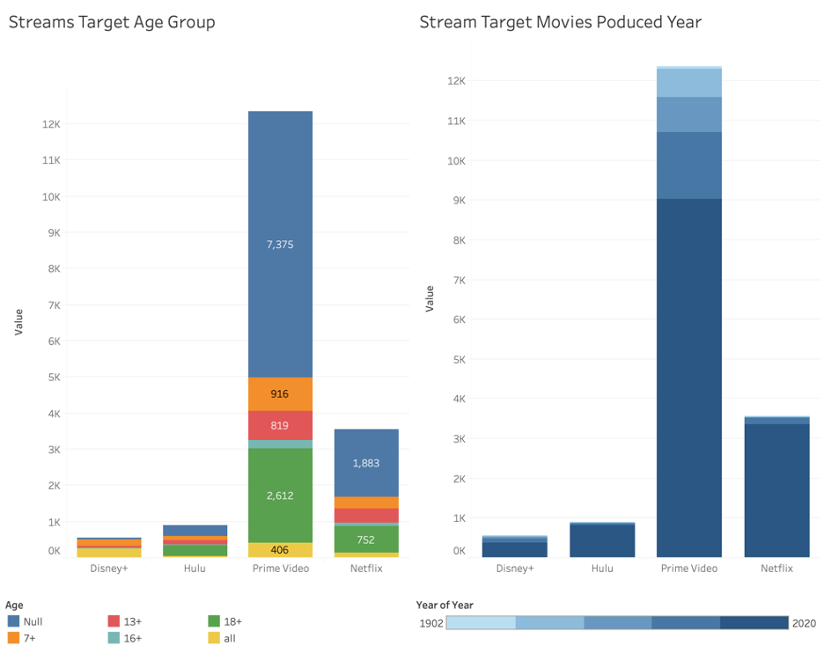
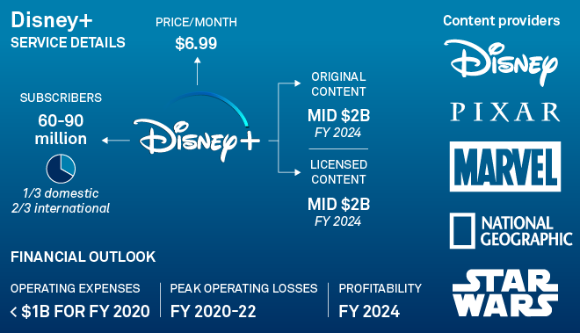
Market Segment Analysis
Introduction
Financial Analysis
Revenue Analysis
Market Segment Analysis
DTC & Internetional
Prime Video earns the largest proportion in stream platfroms
Disney+ unique position
Disney has growing market share while other does not
Notes:
Graph Strems Target Age Group:
Prime Video earns the largest market share among Disney+, Hulu and Netflix. The age group composition of Hulu, Prime Vedio and Netflix is similar. Over half of the consumer are older than 18, 7+ and 13+ age group are the second largest proportion of stream platforms. However for Disney+, its age group is mainly 7+ and all lable. Which shows Disney consumer segment is young childrens and family. After Disney merging Hulu, it is a good strategy to increase it consumer on year 18.
Graph Target Movies Produced Year:
Most stream platforms have movies produced after 1996. In Disney+ Hulu and Netflix, consumer is hard to find movie produced before year 1996 or even earlier back to year 1902. From my point of view, increase process of old movie would be a good way to expand its customer segments.

Slide 14
Investment Recommendation: BUY!!!
EPS Prediction:
Increase from $2.02 per share in FY20 to $4.50 per share in FY22 on a normalized outlook.
Market Stockprice:
Disney+ , synergies of the company's high profile brand of IP would increase stock price.
Notes:
Here comes to the final investment recommendation. In terms of the financial market,the Earning per Share are predicted to increase from 2.02 per share in financial year 2020 to 3.5 per share in financial year 2022. The Market stock price are likely to increase since the Disney+ is the synergy of company high profile brand of IP. In conclusion, if the Walt Disney Company behave like the suggestion above, it is a good signal to buy in stock in a broad view.
Disney has a 38.4x P/E on FY22 estimates, but we still think that this a franchise business that looks encouraging. Their OTT segment has a CAGR of 14% in subscribers and could surpass Netflix in its subscriber base by 2030.
Amusement parks should see a recovery by FY23, and reach pre-Covid levels in terms of net sales. However, they might open earlier, and have higher traffic because of quicker recovery from Covid-19. The cord-cutting has not hurt media networks revenue, with subscription prices staying buoyant.
EPS looks to have an increase from $2.02 per share in FY20 to $4.50 per share in FY22 on a normalized outlook. With a rapid expansion of Disney+ internationally, we see growing synergies of the company's high profile brand of IP to help the company's stock price reach further highs.

